Slide 1
Decidability
Automata Theory
Ege University
Department of Computer Engineering
2010-2011 Fall
Yrd. Doç. Dr. R. Cenk Erdur, 2010

Slide 2
Decidability
Within the scope of finite automata theory, how can we tell whether
  Two regular expressions define the same language?
  Two F.A.’s accept the same language?
  The language defined by an F.A. has finitely many or infinitely many words in it?
Yrd. Doç. Dr. R. Cenk Erdur, 2010

Slide 3
Definition
Effectively Solvable Problem:
  If there is an algorithm that provides the answer in a finite number of steps, then we say that a problem is effectively solvable.
    For example, solution for a quadratic equation.
Yrd. Doç. Dr. R. Cenk Erdur, 2010

Slide 4
Definition
Decision Procedure:
  An effective solution to a problem that has a yes or no answer is called a decision procedure.
  A problem that has a decision procedure is called decidable.
Yrd. Doç. Dr. R. Cenk Erdur, 2010

Slide 5
An Inefficient Method
Is the method given below to decide whether two regular expressions define the same language decidable?
  Suggested method:
    Use the two expressions to generate many words from each language until we find one that obviously is not in the language of the other.
Yrd. Doç. Dr. R. Cenk Erdur, 2010

Slide 6
An Inefficient Method
Are the R.E.’s given below define the same language? There is no mathematical guarantee that we find a different word in the next several years.
  a(a+b)* and (b+Λ)(baa+ba*)* ?
  (aa+ab+ba+bb)* and ((ba+ab)*(aa+bb)*)* ?
  ((b*a)*ab*)* and Λ+a(a+b)*+(a+b)*aa(a+b)* ?
Yrd. Doç. Dr. R. Cenk Erdur, 2010

Slide 7
Comment
We need a decidable procedure to tell whether two regular expressions define the same language.
Yrd. Doç. Dr. R. Cenk Erdur, 2010

Slide 8
Decision Procedure
Build a F.A. for the language below:
  (L₁ ∩ L₂^{′)} + (L₂ ∩ L₁^{′)}
  If L₁ and L₂ are the same language, then this F.A. does not accept any word, including null word.
Yrd. Doç. Dr. R. Cenk Erdur, 2010

Slide 9
Method to Determine Whether an F.A. Accepts Any Words
Examine the F.A. to see whether or not there is a path from – to +. If there is any path, then the machine must accept some words. Procedure for finding out a path from – to +:
  Paint start state blue.
  From every blue state, follow each edge that leads out of it and paint the destination state blue, then delete this edge from the machine.
  Repeat step 2 until no new state is painted blue, then stop.
  When the procedure has stopped, if any of the final states are painted blue, then the machine accepts some words and, if not, does not.
Yrd. Doç. Dr. R. Cenk Erdur, 2010

Slide 10
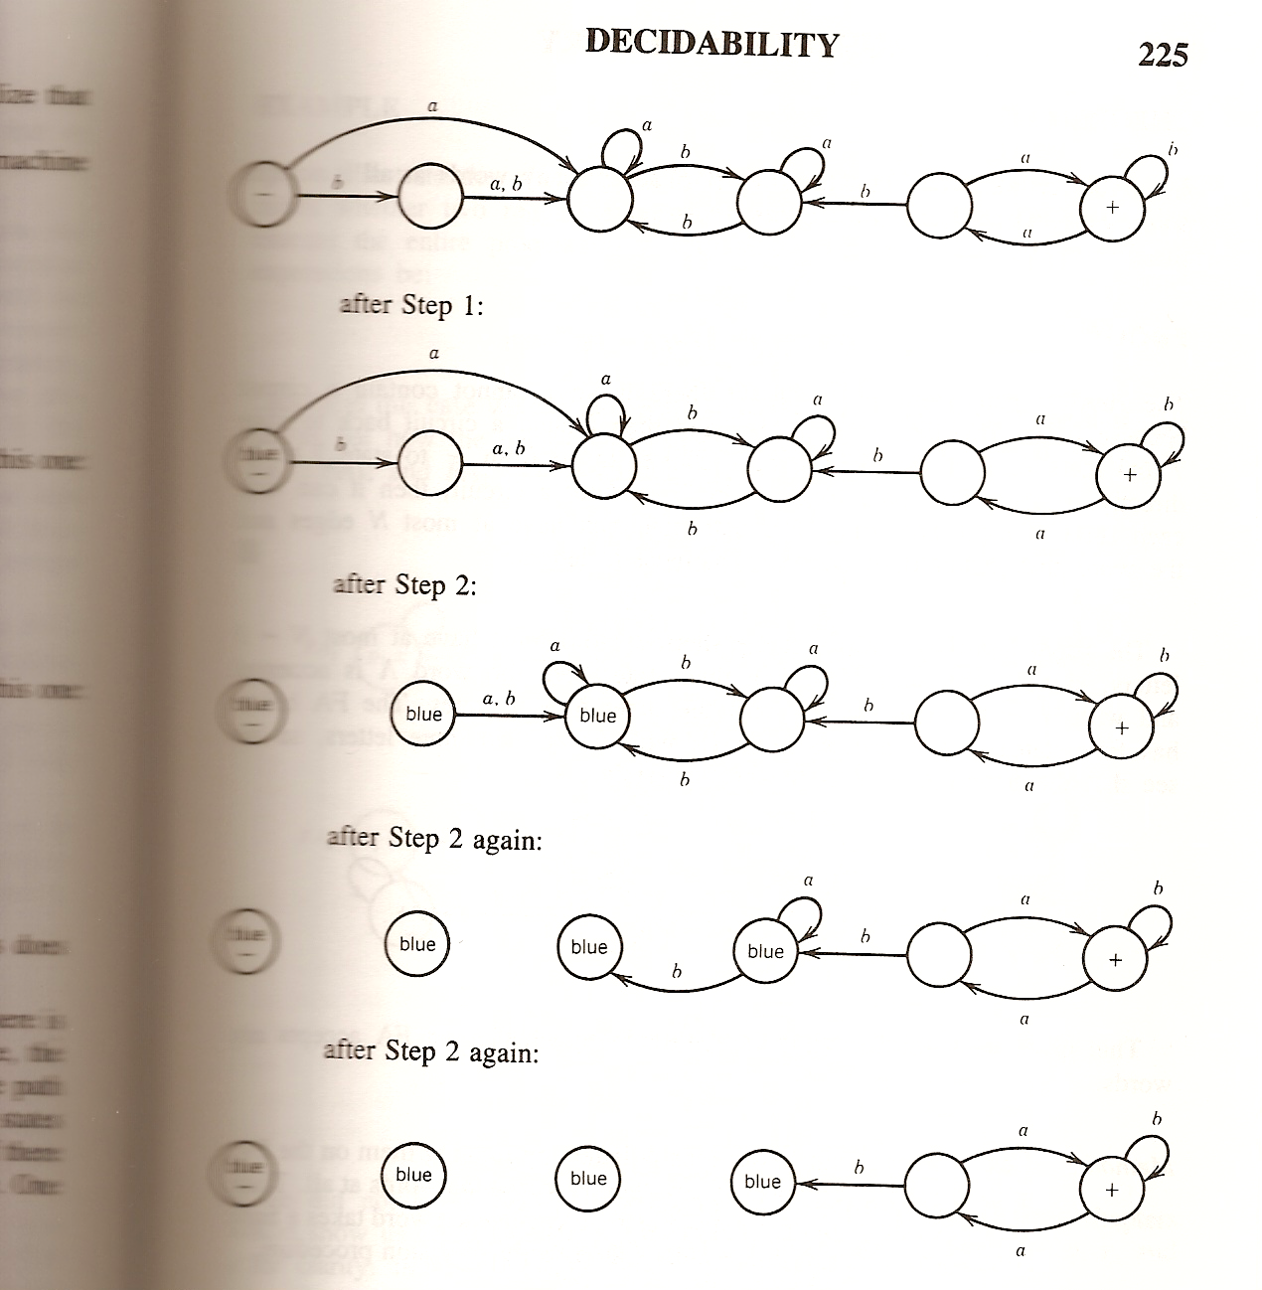
Yrd. Doç. Dr. R. Cenk Erdur, 2010

Slide 11
Discussion
Is the procedure given decidable?
  If there is F.A. with N states and if this F.A. accepts a word, then this F.A. accepts a word with N or fewer letters.
    The shortest path from – to + cannot contain a loop/circuit.
    The shortest word must have at most N-1 letters.
Yrd. Doç. Dr. R. Cenk Erdur, 2010

Slide 12
Method-2
Test all words with fewer than N letters by running them on the F.A. If the F.A. accepts none of them, then it accepts no words at all. There are a predictible number of words to test, and each word takes a finite predictable time to run, so this is an effective decision procedure.
Yrd. Doç. Dr. R. Cenk Erdur, 2010

Slide 13
Example
Two regular expressions are given:
  r₁: a* r₂: Λ + aa*
  Are the two regular expressions equivalent?
    You can see the solution on page 212-214 from textbook. Please read carefully.
Yrd. Doç. Dr. R. Cenk Erdur, 2010

Slide 14
Finiteness
If the regular expression contains * operator, then the language is infinite.
Λ* is an exception to this rule.
Yrd. Doç. Dr. R. Cenk Erdur, 2010

Slide 15
Finiteness
Let F be a F.A. with N states:
  If F accepts an input string w such that N <= length(w) < 2N, then F accepts an infinite language.
  If F accepts infinitely many words, then F accepts some word w such that N <= length(w) < 2N.
Yrd. Doç. Dr. R. Cenk Erdur, 2010

Slide 16
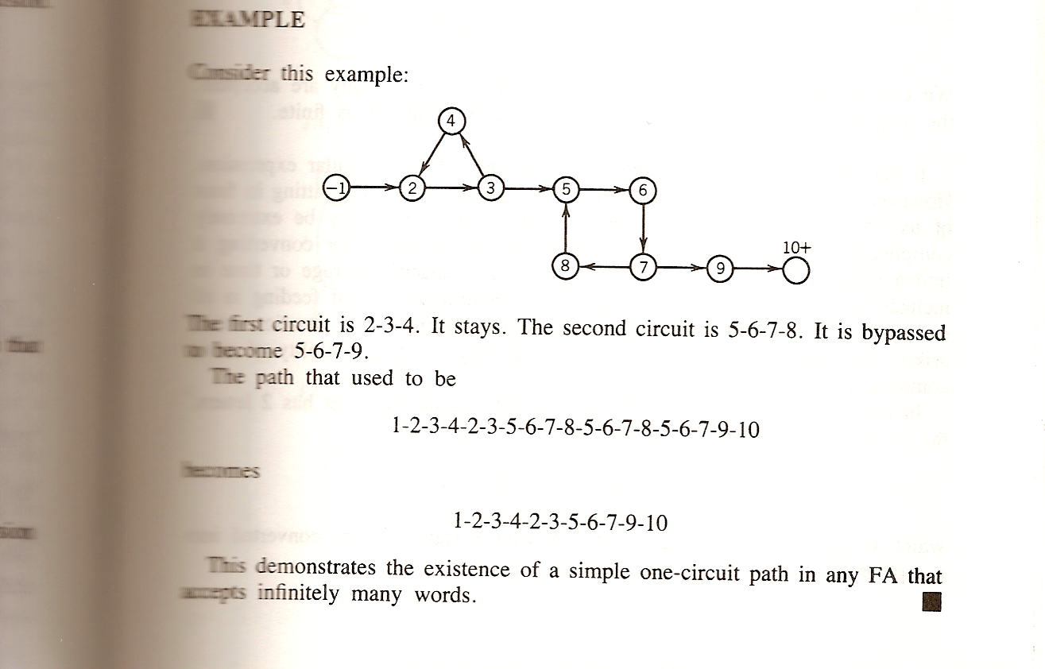
Finiteness
Yrd. Doç. Dr. R. Cenk Erdur, 2010

Slide 17
Finiteness
We test finitely many strings with lengths between N and 2N by running them on the machine and seeing whether any reach a final state. If none does, the language is finite. Otherwise, it is infinite.
Yrd. Doç. Dr. R. Cenk Erdur, 2010

Slide 18
Finiteness
If the machine has N states and the alphabet has m letters, then in total there are;
m^{N} + m^{N+1} + m^{N+2} + ........ + m^{2N-1}
different input strings in the range N <= length of string < 2N
So, the procedure is decidable.
Yrd. Doç. Dr. R. Cenk Erdur, 2010

